Slide 1
Day 3
Classes and Objects; Encapsulation
Jitendra Dubey

Slide 2
Plan of Attack
OOP :
Introduction
Need For OOP
OOP Basics:
class and Objects
constructor
Variable Reference
Class diagram
coding Standards
Assignments: Go To Assignments

Slide 3
Plan of Attack
Using Objects:
Pass By Reference
self
Collection of Objects
Encapsulation:
Need for Encapsulation
Private Attributes
Getter and Setter Method
Relationships:
Introduction
Aggregation

Slide 4
Plan of Attack
Dependency
Assignments: Go To Assignments

Slide 5
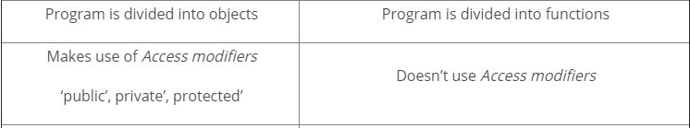
OOP, Introduction
  OOP = Object-Oriented Programming
  OOP is very simple in python
    But also powerful
  Object Oriented Programming is a way of computer programming using the idea of “objects” to represents data and methods
  Difference between Object-Oriented and Procedural Oriented Programming

Slide 6
Why Do We Need For OOP
  Overcome flaws in the procedural approach
  Reusable code
  Maintainability
  Offer better implementation
  Code Manageable programs

Slide 7
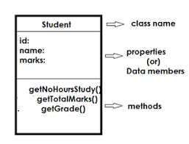
OOP Basics-Class
A class is a collection of objects or you can say it is a blueprint of objects defining the common attributes and behavior
Declaring a class:
class Student:
statements
  Where is “class” is Keyword

Slide 8
OOP Basics-Objects
Objects are an instance of a class. It is an entity that has state and behavior.
In a nutshell, it is an instance of a class that can access the data.
Declaring a Objects:
obj = Student()
Here obj is the “object “ of class1.

Slide 9
Class Examples
class Puppy(object):
def __init__(self, name, color):
self.name = name
self. color = color
  def bark(self):
  print "I am", color, name
  puppyObj = Puppy("Max", "brown")
  puppyObj.bark()
Class: Code that defines the attributes and methods of a kind of object
Instantiate: To create an object; A single object is called an Instance

Slide 10
"Implicit" Parameter (self)
Self represents the instance of the class. By using the "self" keyword we can access the attributes and methods of the class in python
Java: this, implicit
  public void translate(int dx, int dy) {
  x += dx; // this.x += dx;
  y += dy; // this.y += dy;
  }
Python: self, explicit
  def bark(self, name, color):
  self.name = name
  self.color = color

Slide 11
Constructors
def __init__(self, parameter, ..., parameter):
statements
  a constructor is a special method with the name __init__
  Example:
  class Point:
  def __init__(self, x, y):
  self.x = x
  self.y = y
  ...
    How would we make it possible to construct a
    Point() with no parameters to get (0, 0)?

Slide 12
Calling Methods
A client can call the methods of an object in two ways:
  (the value of self can be an implicit or explicit parameter)
1) object.method(parameters)
or
2) Class.method(object, parameters)
Example:
  p = Puppy("Max", "brown")
  Puppy("Max", "brown")

Slide 13
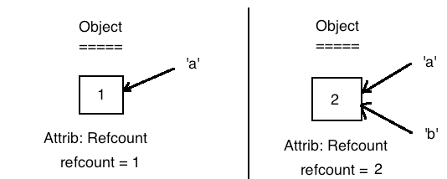
Variable Reference
A reference is a name that refers to the specific location in memory of a value (object).
References take the form of variables, attributes, and items
In python when we assign a value to a name, we actually create an object and a reference to it.
For example in a=1, an object with value '1' is created in memory and a reference 'a' now points to it
a=1 b=1 c=2
Print(id(a))
Print(id(b))

Slide 14
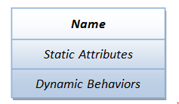
Class diagram
A class diagram describes the types of objects in the system and the different kinds of relationships which exist among them
Class Diagram provides an overview of how the application is structured before studying the actual code
An object contains attributes: data attributes (or static attribute or variables) and dynamic behaviors called methods.

Slide 15
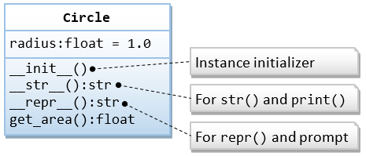
Class diagram
Example: a Circle class
Benefits of Class Diagram
Class Diagram Illustrates data models for even very complex information systems
It certainly reduces the maintenance time
It helps for better understanding of general schematics of an application.

Slide 16
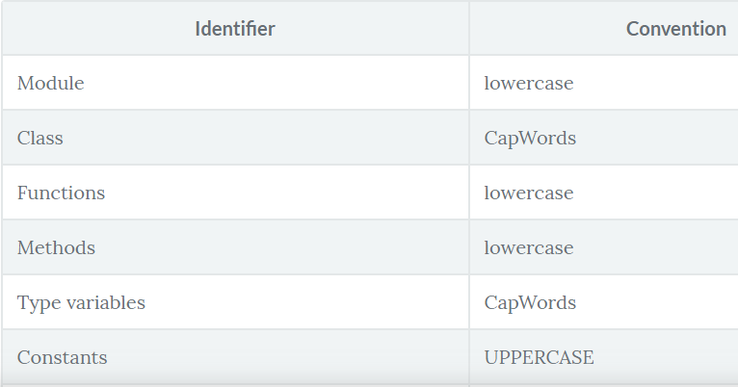
Coding Standards
Indentation
  Use 4 spaces per indentation level.
Maximum Line Length
Naming Conventions
comments

Slide 17
Using Objects:
Examples 1:
class Person:
def __init__(self, name, age):
self.name = name
self.age = age
def myfunc(self):
print("Hello my name is " + self.name)
p1 = Person("John", 36)
p1.myfunc()
Examples 2:
class Person:
def __init__(self, name, age):
self.name = name
self.age = age
p1 = Person("John", 36)
print(p1.name)
print(p1.age)

Slide 18
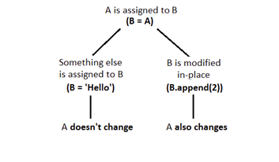
Pass By Reference
In Python all mutable variables are passed by reference.

Slide 19
Collection of Objects
Example
class Shark:
def __init__(self, name, age):
self.name = name
self.age = age
new_shark = Shark("Sammy", 5)
print(new_shark.name)
print(new_shark.age)
stevie = Shark("Stevie", 8)
print(stevie.name)
print(stevie.age)

Slide 20
Assignments
Python program that creates a class with single method?
Python program that creates a class with constructor and single method?
How to create an empty class?

Slide 21
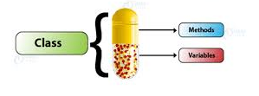
Encapsulation
Encapsulation basically means binding up of data in a single class
Python does not have any use private keyword
Private keyword denote by “underscore “
class shouldn’t be directly accessed but be prefixed in an underscore.

Slide 22
Need for Encapsulation
Encapsulation Helpful? Encapsulation helps to create code that is loosely coupled. Because the details are hidden
It reduces the ability of other objects to directly modify an object's state and behavior
Data encapsulation led to the important OOP concept of data hiding.
Keeps both safe from outside interference and misuse
class Base:
def __init__(self):
# Protected member
self._a = 2
obj1 = Base()
print(obj1._a)

Slide 23
Private Attributes
Example
class MyClass:
# Hidden member of MyClass
__hiddenVariable = 0
# A member method that changes
def add(self, increment):
self.__hiddenVariable += increment
print (self.__hiddenVariable)
# Driver code
myObject = MyClass()
myObject.add(2)
myObject.add(5)
# This line causes error
print (myObject.__hiddenVariable)

Slide 24
Getter and Setter Method
Private variables are intended to be changed using getter and setter methods.
class Animal
def __init__(self, age = 0):
self._age = age
# getter method
def get_age(self):
return self._age
# setter method
def set_age(self, x):
self._age = x
raj = Animal ()
# setting the age using setter
raj.set_age(21)
print(raj.get_age())
print(raj._age)

Slide 25
Relationships in class
Relationships
There are mainly three kinds of relationships in UML (Unified Modeling Language) :
  Dependencies
  Generalizations
  Associations
UML- purpose of visually representing a system
-UML is not a programming language
- UML helps software engineers, businessmen and system architects with modeling, design and analysis
- It started in 1997 by Object Management Group.

Slide 26
Types of UML
Basically of two types:
- Structural Diagrams
Capture static aspects or structure of a system
Exam:
Structural Diagrams include: Component Diagrams, Object Diagrams, Class Diagrams and Deployment Diagrams.
- Behavior Diagrams
Capture dynamic aspects or behavior of the system
Behavior diagrams include: Use Case Diagrams, State Diagrams, Activity Diagrams and Interaction Diagrams.

Slide 27

Types of Relationship
Dependency:
A dependency means the relation between two or more classes in which a change in one may force changes in the other
it will always create a weaker relationship
- Dependency indicates that one class depends on another
Example, Student has a dependency on College

Slide 28
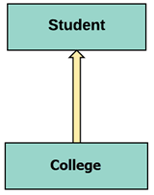
Types of Relationship
Generalization:
A generalization helps to connect a subclass to its superclass.
A sub-class is inherited from its superclass.
Generalization relationship can't be used to model interface implementation

Slide 29

Types of Relationship
Aggregation:
Aggregation is a special type of association
- whole- part relationship between aggregate and its parts.
- For example, the class college is made up of one or more student. In aggregation, the contained classes are never totally dependent on the lifecycle of the container.

Slide 30
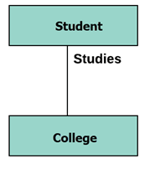
Types of Relationship
Association:
Represents static relationships between classes A and B
Example, the relationship between student and college

Slide 31
Go to Assignment
Creating Class and Object in Python
Make all of the variables in the Car class private.
try to print one of the variables after an object has been instantiated
class Car(object):
def __init__(self, make = 'Ford', model = 'Pinto', year = '1971', mileage = '253812', color = 'orange'):
self.__make = make
self.__model = model
self.__year = year
self.__mileage = mileage
self.__color = color
def move_forward(self, speed):
print("Your %s is moving forward at %s" % (self.__model, speed))
def move_backward(self, speed):
print("Moving backward at %s" % speed)
mycar = Car()
print(mycar.__model)

Slide 32
        Thank You

